Slide 1
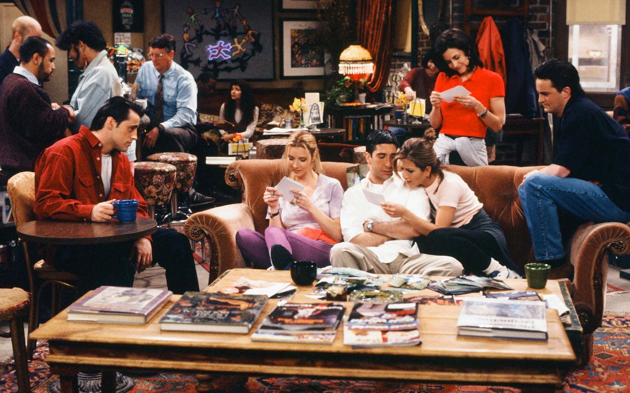

Slide 2












$$N\left(t\right)$$
$$δ_{3}$$
$$3$$
$$2$$
$$δ_{2}$$
$$δ_{1}$$
$$1$$
$$0$$
$$t$$
$$T_{1}$$
$$T_{2}$$
$$T_{3}$$

Slide 3



$$N\left(t\right)$$
$$δ_{3}$$
$$3$$
$$2$$
$$δ_{2}$$
$$δ_{1}$$
$$1$$
$$0$$
$$t$$
$$0.5$$
$$1$$
$$1.5$$

Slide 4








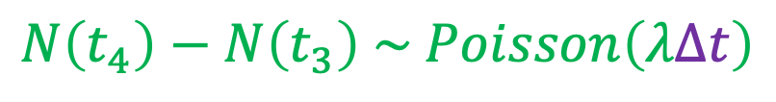



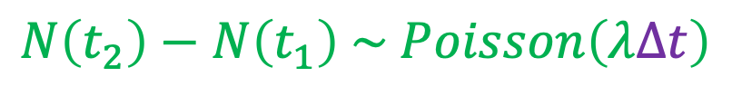
$$N\left(t\right)$$
$$N\left(t_{4}\right)$$
$$N\left(t_{4}\right)−N\left(t_{3}\right) \sim Poisson\left(λΔt\right)$$
$$N\left(t_{3}\right)$$
$$N\left(t_{2}\right)$$
$$N\left(t_{2}\right)−N\left(t_{1}\right) \sim Poisson\left(λΔt\right)$$
$$N\left(t_{1}\right)$$
$$t_{2}−t_{1} = Δt = t_{4}−t_{3}$$
$$0$$
$$t_{1}$$
$$t_{2}$$
$$t_{3}$$
$$t_{4}$$
$$t$$

